Slide 1
Introduction & Basic Functions
Presented by Manal Asghar

Slide 2
Introduction to Microsoft Excel
Developed by Microsoft as part of the Microsoft Office suite.
Works with spreadsheets – organized into rows and columns.
Used for:
Data analysis
Performing mathematical operations
Creating charts and graphs
Maintaining records like inventory, payroll, and student marksheets
Supports formulas and functions like SUM, AVERAGE, IF, etc.
Helps in visualizing data using:
Bar charts, pie charts, line graphs
Conditional formatting
Useful in a wide range of fields:
Business
Education
Accounting
Engineering
Works on Windows, Mac, and Online (Excel for Web)

Slide 3
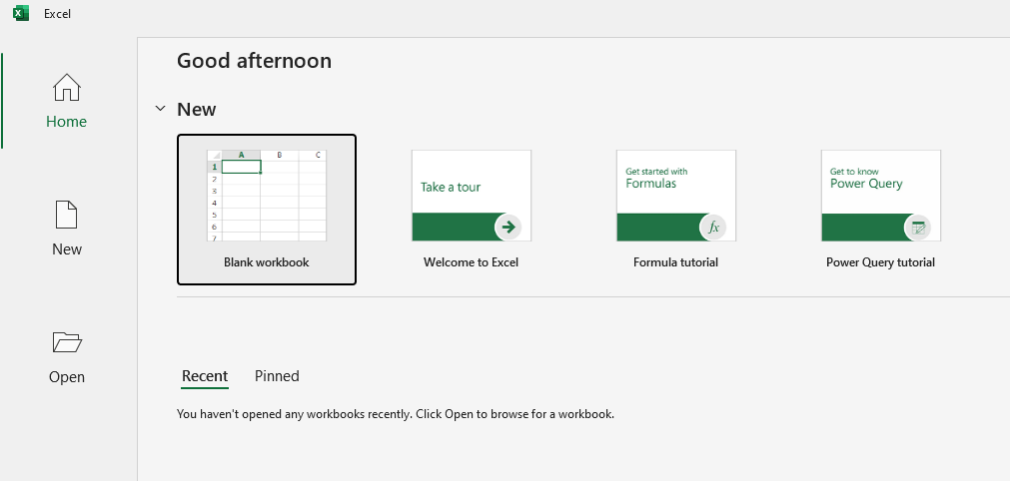
Creating a Worksheet
Open Excel → Blank Workbook

Slide 4
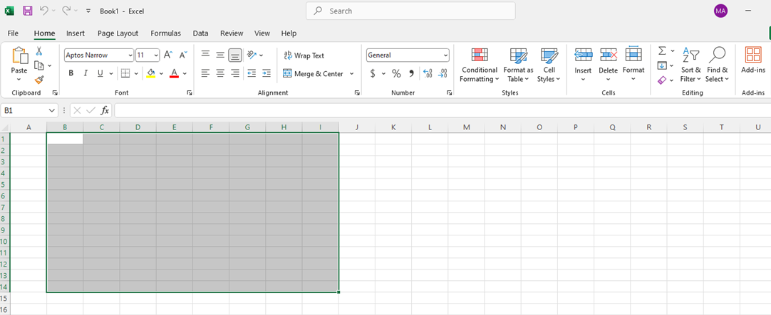
Excel Interface Overview
Ribbon Tabs: Home, Insert, Formulas, etc.
Rows and Columns: Grid for data
Formula Bar: Shows/edit cell formula
Name Box: Shows active cell address
Enter data in rows and columns

Slide 5
Cell Referencing & Auto Fill
A1, B2, C3 = Cell addresses
Relative reference (A1) → Changes when dragged
Absolute reference ($A$1) → Fully fixed ($A$1)
Mixed reference (A$1 or $A1) → Partially fixed (A$1 or $A1)

Slide 6
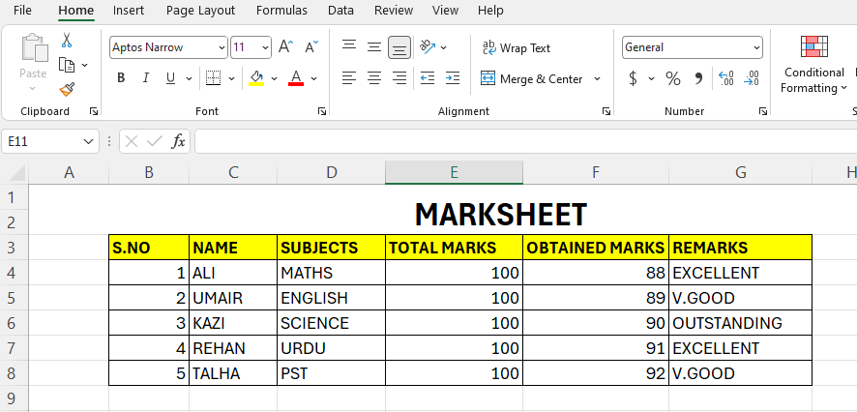
Creating a First Spreadsheet
Example: Student Marksheet

Slide 7
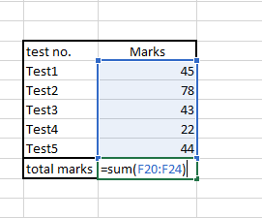
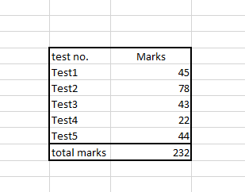
Using SUM Function
Formula: =SUM(B2:D2)
Adds values from B2 to D2 (e.g., total marks)
Example:
=SUM(85, 78, 90) = 253

Slide 8
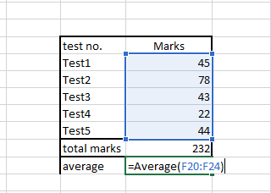
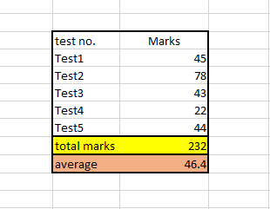
Using AVERAGE Function
Formula: =AVERAGE(B2:D2)
Calculates mean value
Example:
=AVERAGE(85, 78, 90) = 84.33

Slide 9
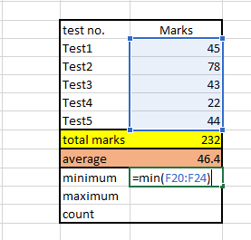
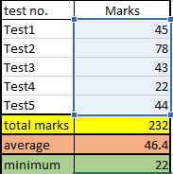
Using MIN, MAX & COUNT
MIN: =MIN(B2:D2) → Finds lowest
MAX: =MAX(B2:D2) → Finds highest
COUNT: =COUNT(B2:D4) → Counts numeric entries

Slide 10
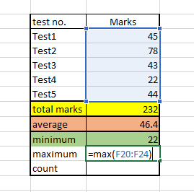
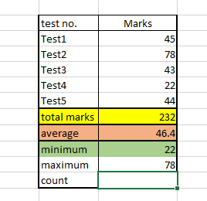
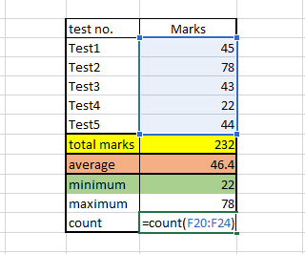
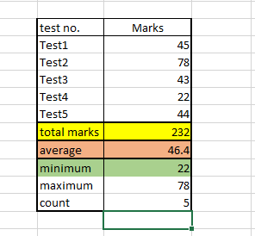

Slide 11
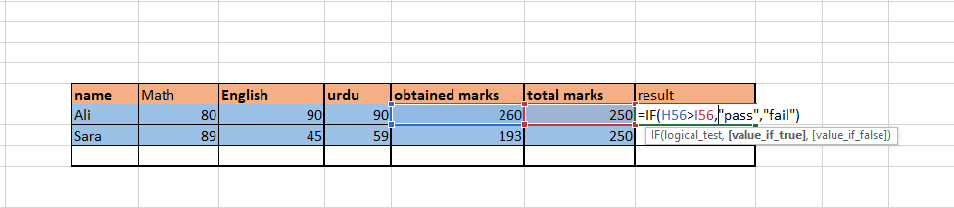
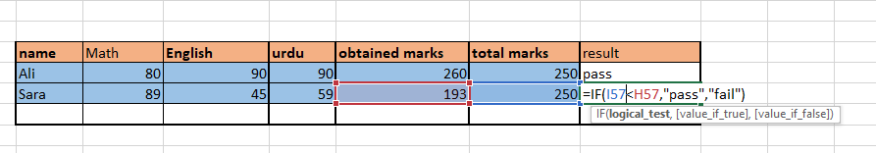
Using IF Function
Formula: =IF(E2>250, "Pass", "Fail")
Checks condition and returns result
Example:
=IF(253>250, "Pass", "Fail") → Pass

Slide 12
Combining Functions
Example: Total + Average + Pass/Fail
Total: =SUM(B2:D2)
Avg: =AVERAGE(B2:D2)
Result: =IF(E2>250, "Pass", "Fail")

Slide 13
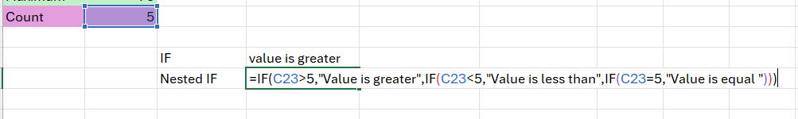
Nested IF
A Nested IF is used in Excel when we need to check multiple conditions within a single formula.
It means placing one IF function inside another IF function to return different results based on different conditions.

Slide 14
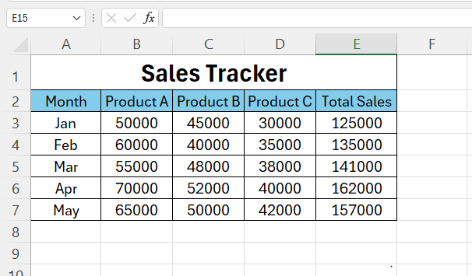
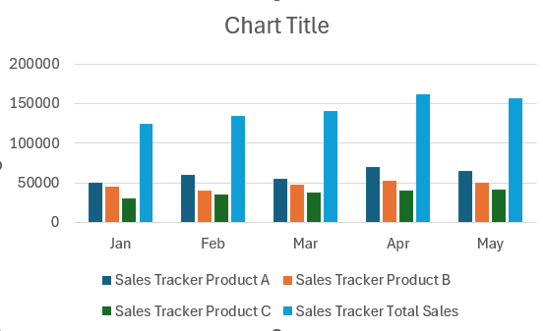
Practical Task: Create a Sales Tracker with Charts

Slide 15
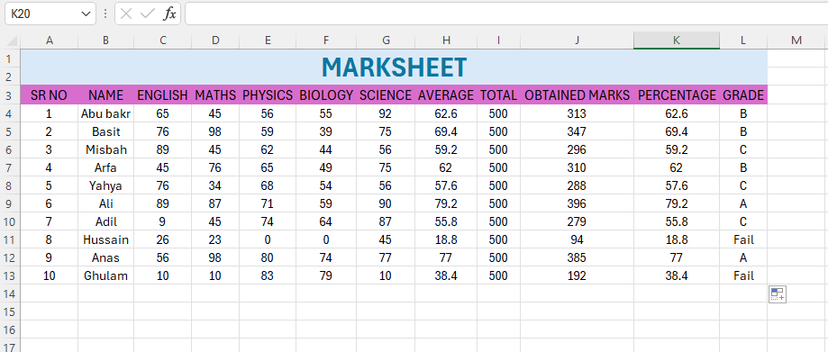
Practical Task

